Slide 1
Introduction
Lecture 1

Slide 2

Welcome
To
Human Computer Interaction
CSC 456

Slide 3



Instructors
Amaid Zia
Dr. Faizan Ahmad
Sara Muneeb

Slide 4
Agenda
1
Course Overview
Learning Resources , Submissions , Marks Allocation etc.
2
Introduction to HCI process
Motivation , Basic design process , Course Roadmap

Slide 5
Marks Scheme
Sessional 1
10 %
Sessional 2
15 %
Terminal
50 %
4xQuizzes
15 %
4xAssign.
10 %

Slide 6
Text Book
No one
fixed
Text Book
We’ll be using
Multiple
Resources

Slide 7

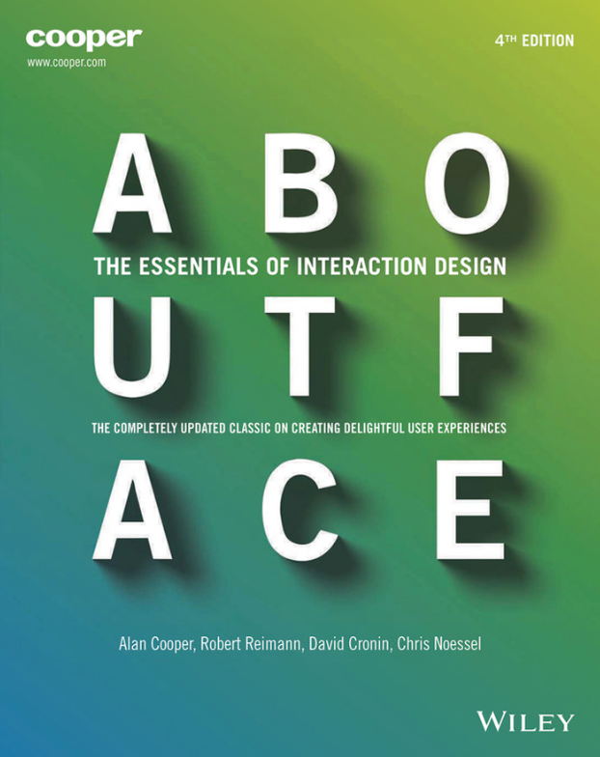

Text Book
1
2
3

Slide 8
Topics
Till S1
Till S2
Till Terminal
Class Overview Introduction about HCI HCI defined, topics in HCI
The psychopathology of everyday things
The psychology of everyday things Structure of human memory
To Err is Human Conceptual Model, Psychopathology of computers
Interfaces hall of shame, user centered vs. system centered design Usability and Usability Engineering
Know the User
Know the User (Qualitative research methods) Know the User (Ethnographic interviews)
Usability benchmarking Personas
Defining Scenarios for Personas Prototyping
Heuristics Evaluation Cognitive Walk-through, Guideline checking, Action Analysis, Guideline Scoring
A/B testing, usage studies, query techniques Usability in practice
Web Usability Mobile Applications Usability
Typography, Icon design Grids and Alignments Project Presentations
Reading and Navigating Project Presentations
History of HCI Project Presentations

Slide 9
Overview Of HCI

Slide 10

What Is H.C.I

Slide 11
“ Human-computer interaction is a discipline concerned with the design, evaluation and implementation of interactive computing systems for human use and with the study of major phenomena surrounding them.
”
Taken from: ACM SIGCHI Curricula for Human-Computer Interaction

Slide 12
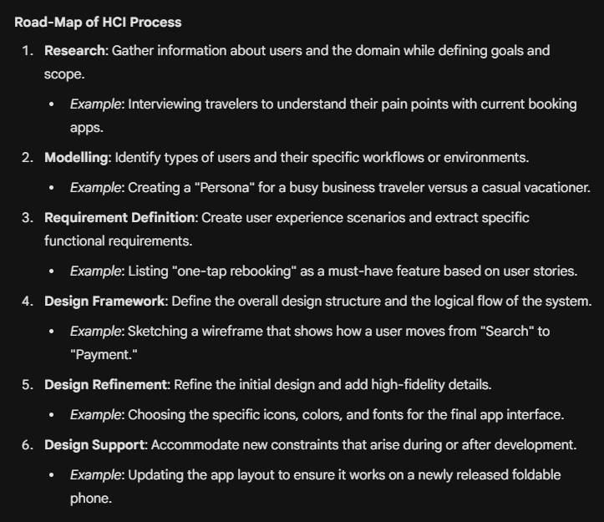
Making a Product
Initiate
Build
Test
Ship
Design

Slide 13

Road-Map of HCI process
1
Research
Gather Information about users and domain
Define goals and Scope

Slide 14

2
Modelling
Types of users
Workflow , environment etc.

Slide 15

3
Requirement Definition
User experience Scenarios
Extract Requirements

Slide 16

4
Design Framework
Define Design Structure
Define Flow

Slide 17

5
Design Refinement
Refine Design
Add Details

Slide 18

6
Design Support
Accommodate new constraints

Slide 19
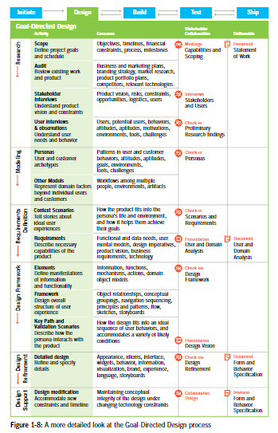
From Book 2 : About Face : Essentials of interaction designs

Slide 20
Assignment
Reading :Page 21-30 , Topic : Overview of goal-directed design from Book 2 i.e. About Face: Essentials of Interaction Designs by Alan Cooper
Search what is ACM SIGCHI and what type of content does it contain ?

Slide 21
The End

